Slide 1
Mock Server
Easy mocking of any system you integrate with via HTTP or HTTPS

Slide 2
Why do I want a Mock Server?
When you are doing integration tests, and the service disappears temporarily.
When doing integration tests, you need to see that your app talked with an external service and how.
When you’re testing, you may want to see what your app is doing to an external service.
When not working on a service integration directly, other developers don’t want to have to setup an external service to work on their task.
Emulating an error condition that doesn’t normally happen with the normal service.

Slide 3
SETUP
Ensure you have docker for desktop installed.
Clone https://github.com/kassah/mockserver-pres to a local folder
Ensure you have the latest version for the presentation by doing `git pull`
Run `make pull` to fetch dependent containers
Ensure you have port 80 and 443 clear locally (shut down any development app instances)
Run `make up` to start the services.

Slide 4
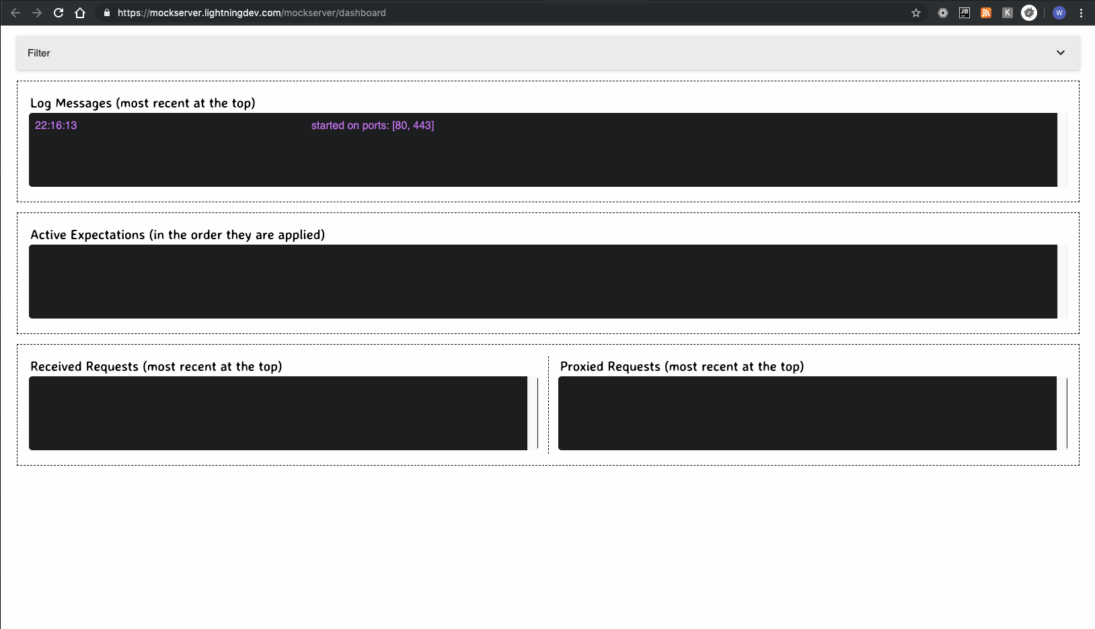

MockSErver Dashboard

Slide 5
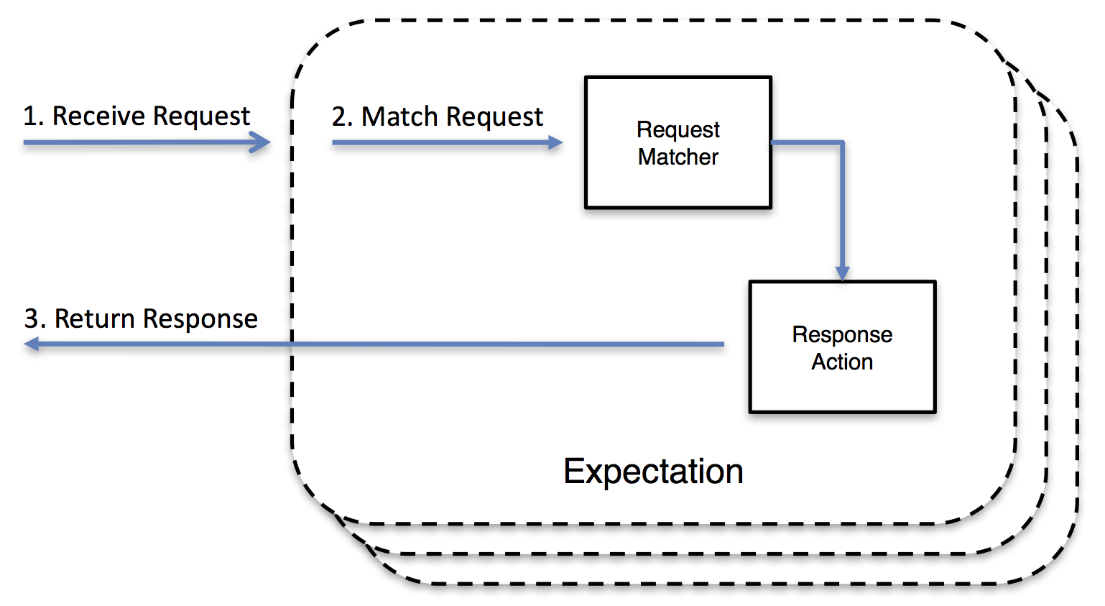
Mock a Service concept

Slide 6
Creating a SIMPLE EXPECTATION
curl -v -X PUT "https://mockserver.lightningdev.com/mockserver/expectation" -d '{ "httpRequest" : { "method" : "GET", "path" : "/some/path" }, "httpResponse" : { "body" : "some_response_body" } }'
Can also be found in the repository in samples/expectations1.sh

Slide 7
See it LIVE
https://mockserver.lightningdev.com/some/path
Check the dashboard to see your request.

Slide 8
No Expectation Matched
Go to https://mockserver.lightningdev.com/other
See dashboard for why

Slide 9
Clear
curl -v -X PUT https://mockserver.lightningdev.com/mockserver/clear
Or use the shortcut `make clear-all` in our project
Refresh your dashboard to see it clean.
More on this can be found at: http://www.mock-server.com/mock_server/clearing_and_resetting.html

Slide 10
Documentation
Creating Expectations:
http://www.mock-server.com/mock_server/creating_expectations.html

Slide 11
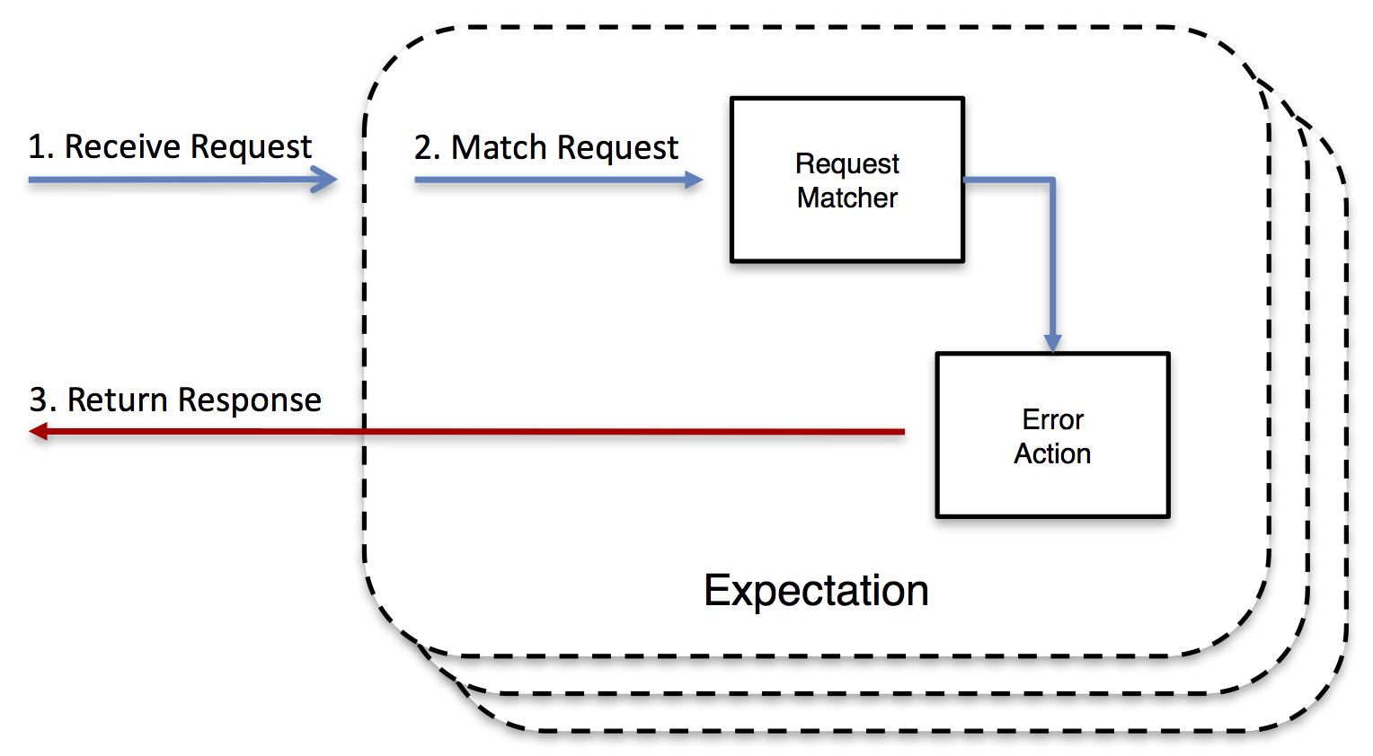
Return aN Error Concept

Slide 12
Creating RANDOM BYTE OUTPUT
curl -v -X PUT "http://mockserver.lightningdev.com/mockserver/expectation" -d '{ "httpRequest": { "path": "/some/path" }, "httpError": { "dropConnection": true, "responseBytes": "eQqmdjEEoaXnCvcK6lOAIZeU+Pn+womxmg==" } }'
Can also be found in the repository in samples/error1.sh

Slide 13
See it in ACTION
https://mockserver.lightningdev.com/some/path
Or curl -v https://mockserver.lightningdev.com/some/path
Check the dashboard to see your request.

Slide 14
Clear
curl -v -X PUT https://mockserver.lightningdev.com/mockserver/clear
Or use the shortcut `make clear-all` in our project
Refresh your dashboard to see it clean.
More on this can be found at: http://www.mock-server.com/mock_server/clearing_and_resetting.html

Slide 15
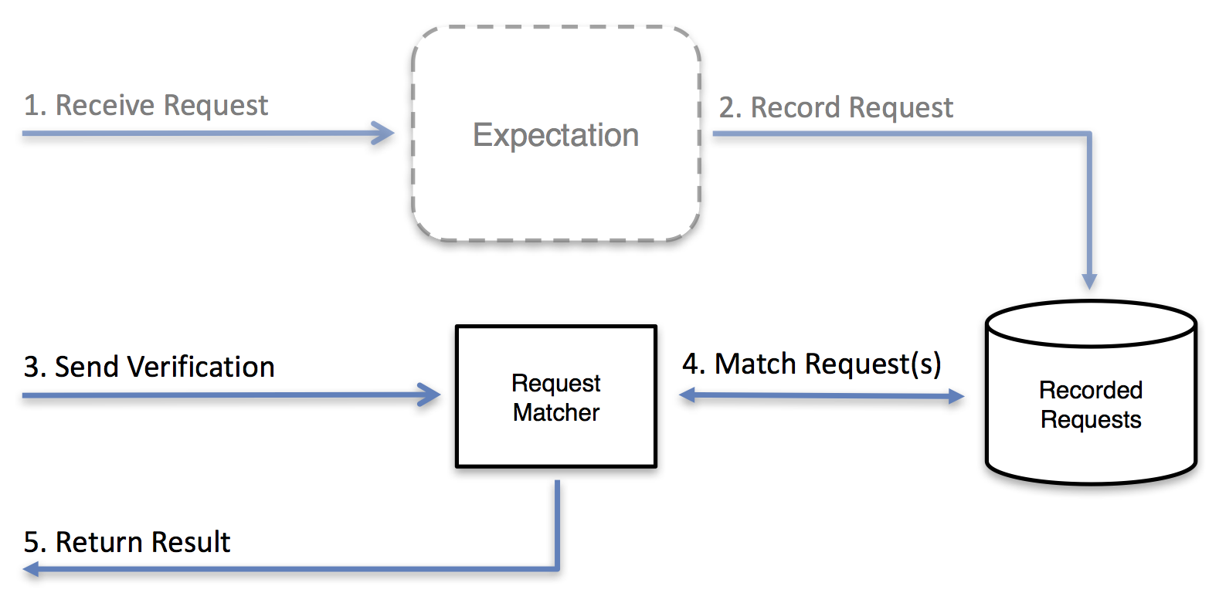
VERIFY REQUESTS CONCEPT

Slide 16
Setting up expectation to verify
curl -v -X PUT "https://mockserver.lightningdev.com/mockserver/expectation" -d '{ "httpRequest" : { "method" : "GET", "path" : "/simple" }, "httpResponse" : { "body" : "call this multiple times." } }'
Can also be found in the repository in samples/expectation2.sh

Slide 17
Verification (FAIL)
curl -v -X PUT "https://mockserver.lightningdev.com/mockserver/verify" -d '{ "httpRequest": { "path": "/simple" }, "times": { "atLeast": 1 } }'
Can also be found in the repository in samples/verify1.sh

Slide 18
Hit the verify point!
https://mockserver.lightningdev.com/simple
Or curl -v https://mockserver.lightningdev.com/simple
Check the dashboard to see your requests.

Slide 19
Verification (SUCCESS!)
curl -v -X PUT "https://mockserver.lightningdev.com/mockserver/verify" -d '{ "httpRequest": { "path": "/simple" }, "times": { "atLeast": 1 } }'
Can also be found in the repository in samples/verify1.sh

Slide 20
Clear
curl -v -X PUT https://mockserver.lightningdev.com/mockserver/clear
Or use the shortcut `make clear-all` in our project
Refresh your dashboard to see it clean.
More on this can be found at: http://www.mock-server.com/mock_server/clearing_and_resetting.html

Slide 21
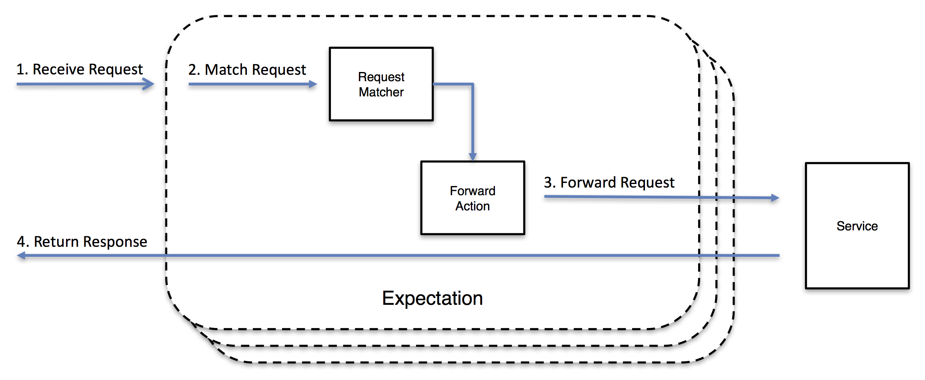
Forward a Request Concept

Slide 22
Look at our PHP App
app/public/index.php
Ipify.org

Slide 23
Test without Mockserver
Go to: https://mockserver.lightningdev.com/app/
Or use shortcut `make php`

Slide 24
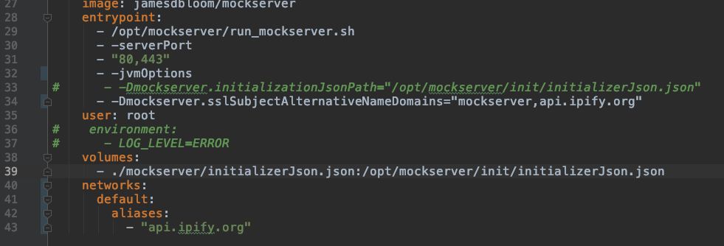
MODIFY DOCKER-COMPOSE.YML
Uncomment lines 32,34 and 40-43

Slide 25
Restart your cluster
`make reup` to pickup your changed docker-compose.yml

Slide 26
SETUP FORWARD FOR IPIFY SERVICE
curl -v -X PUT "https://mockserver.lightningdev.com/mockserver/expectation" -d " { 'httpRequest': { 'headers': { 'host': [ 'api.ipify.org' ] } }, 'httpForward': { 'host': 'api.ipify.org', 'port': 443, 'scheme': 'HTTPS' } } "
Can also be found in the repository in samples/forward1.sh

Slide 27
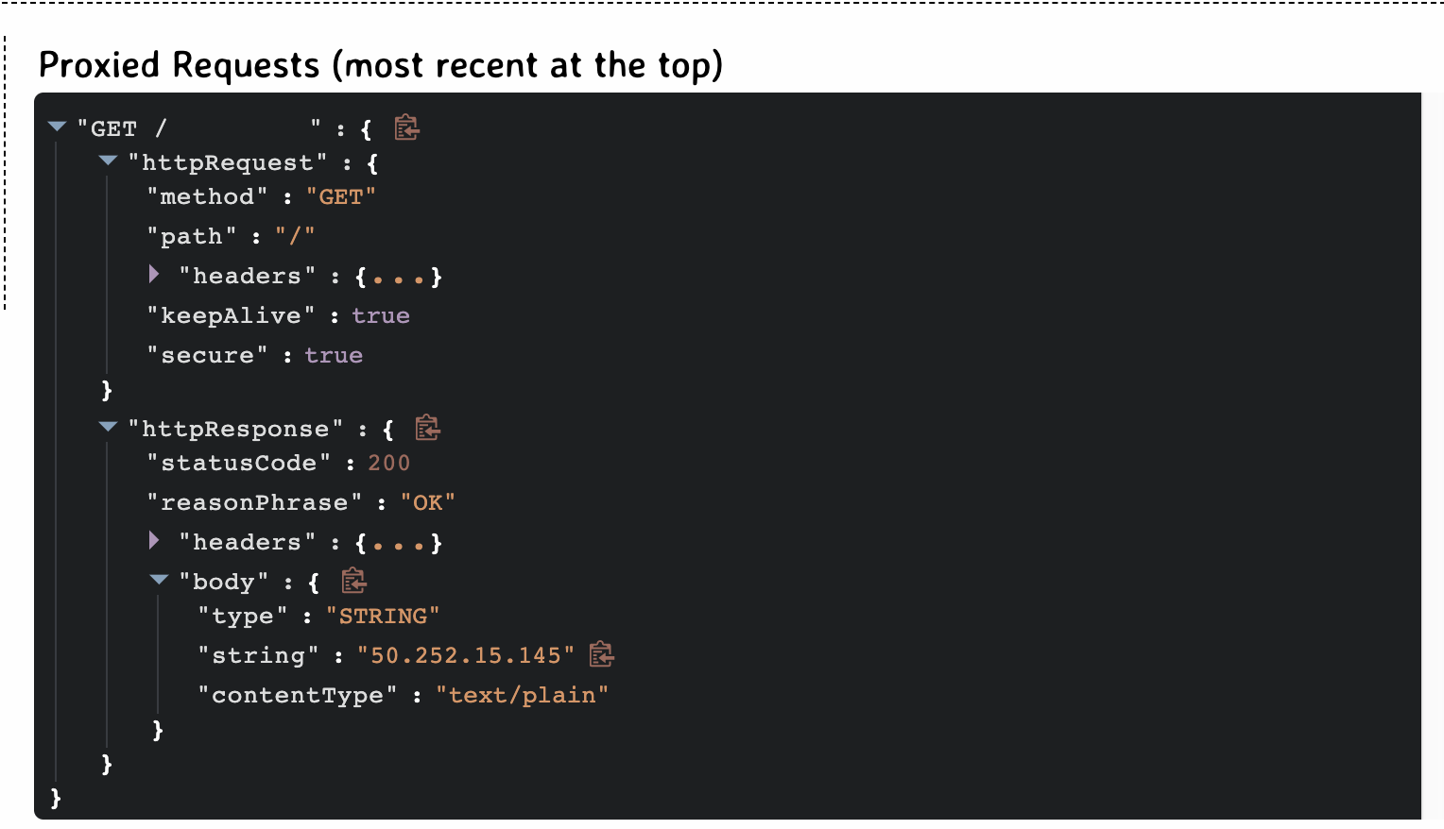
Test with FORWARDER
Go to: https://mockserver.lightningdev.com/app/
Or use shortcut `make php`
You will see same result as before, but now dashboard will show your forwarded request.

Slide 29
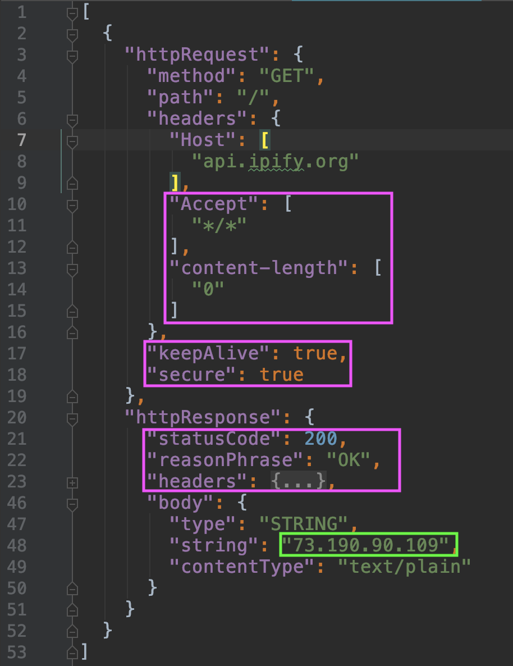
CREATE EXPECTATION
Create file `mockserver/expectations/apify.json` as a copy of `init.json` from the same folder.
Paste your clip board into this file.
Then trim your excess
Change the response text
Add [ and ] around the whole thing!
Ensure valid JSON!
Trimmed version also available in samples/apify.json in repo

Slide 30
Compile our expecations
`make expecations` will generate an init file for our mockserver
Uncomment line 33 in your docker-compose.yml
`make reup` to load the new expectation at startup.
Problems?
Check the logs `docker-compose logs –f mockserver`
Check the compiled expectations in mockserver/initializerJson.json

Slide 31
TesT YOUR NEW EXPECTATION
Go to: https://mockserver.lightningdev.com/app/
Or use shortcut `make php`

Slide 32
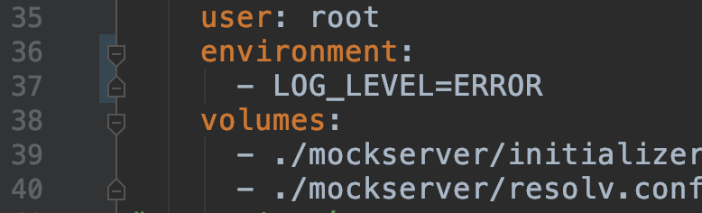
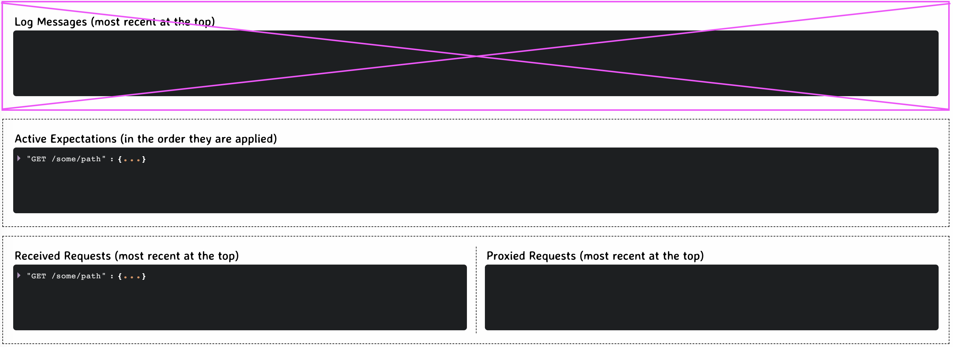
Trouble shooting HIGH MEMORY
On repeated large queries, MockServer memory can balloon at over 12GB
On lines 36 & 37 of docker compose, you can surpress log output.
Results in:

Slide 33
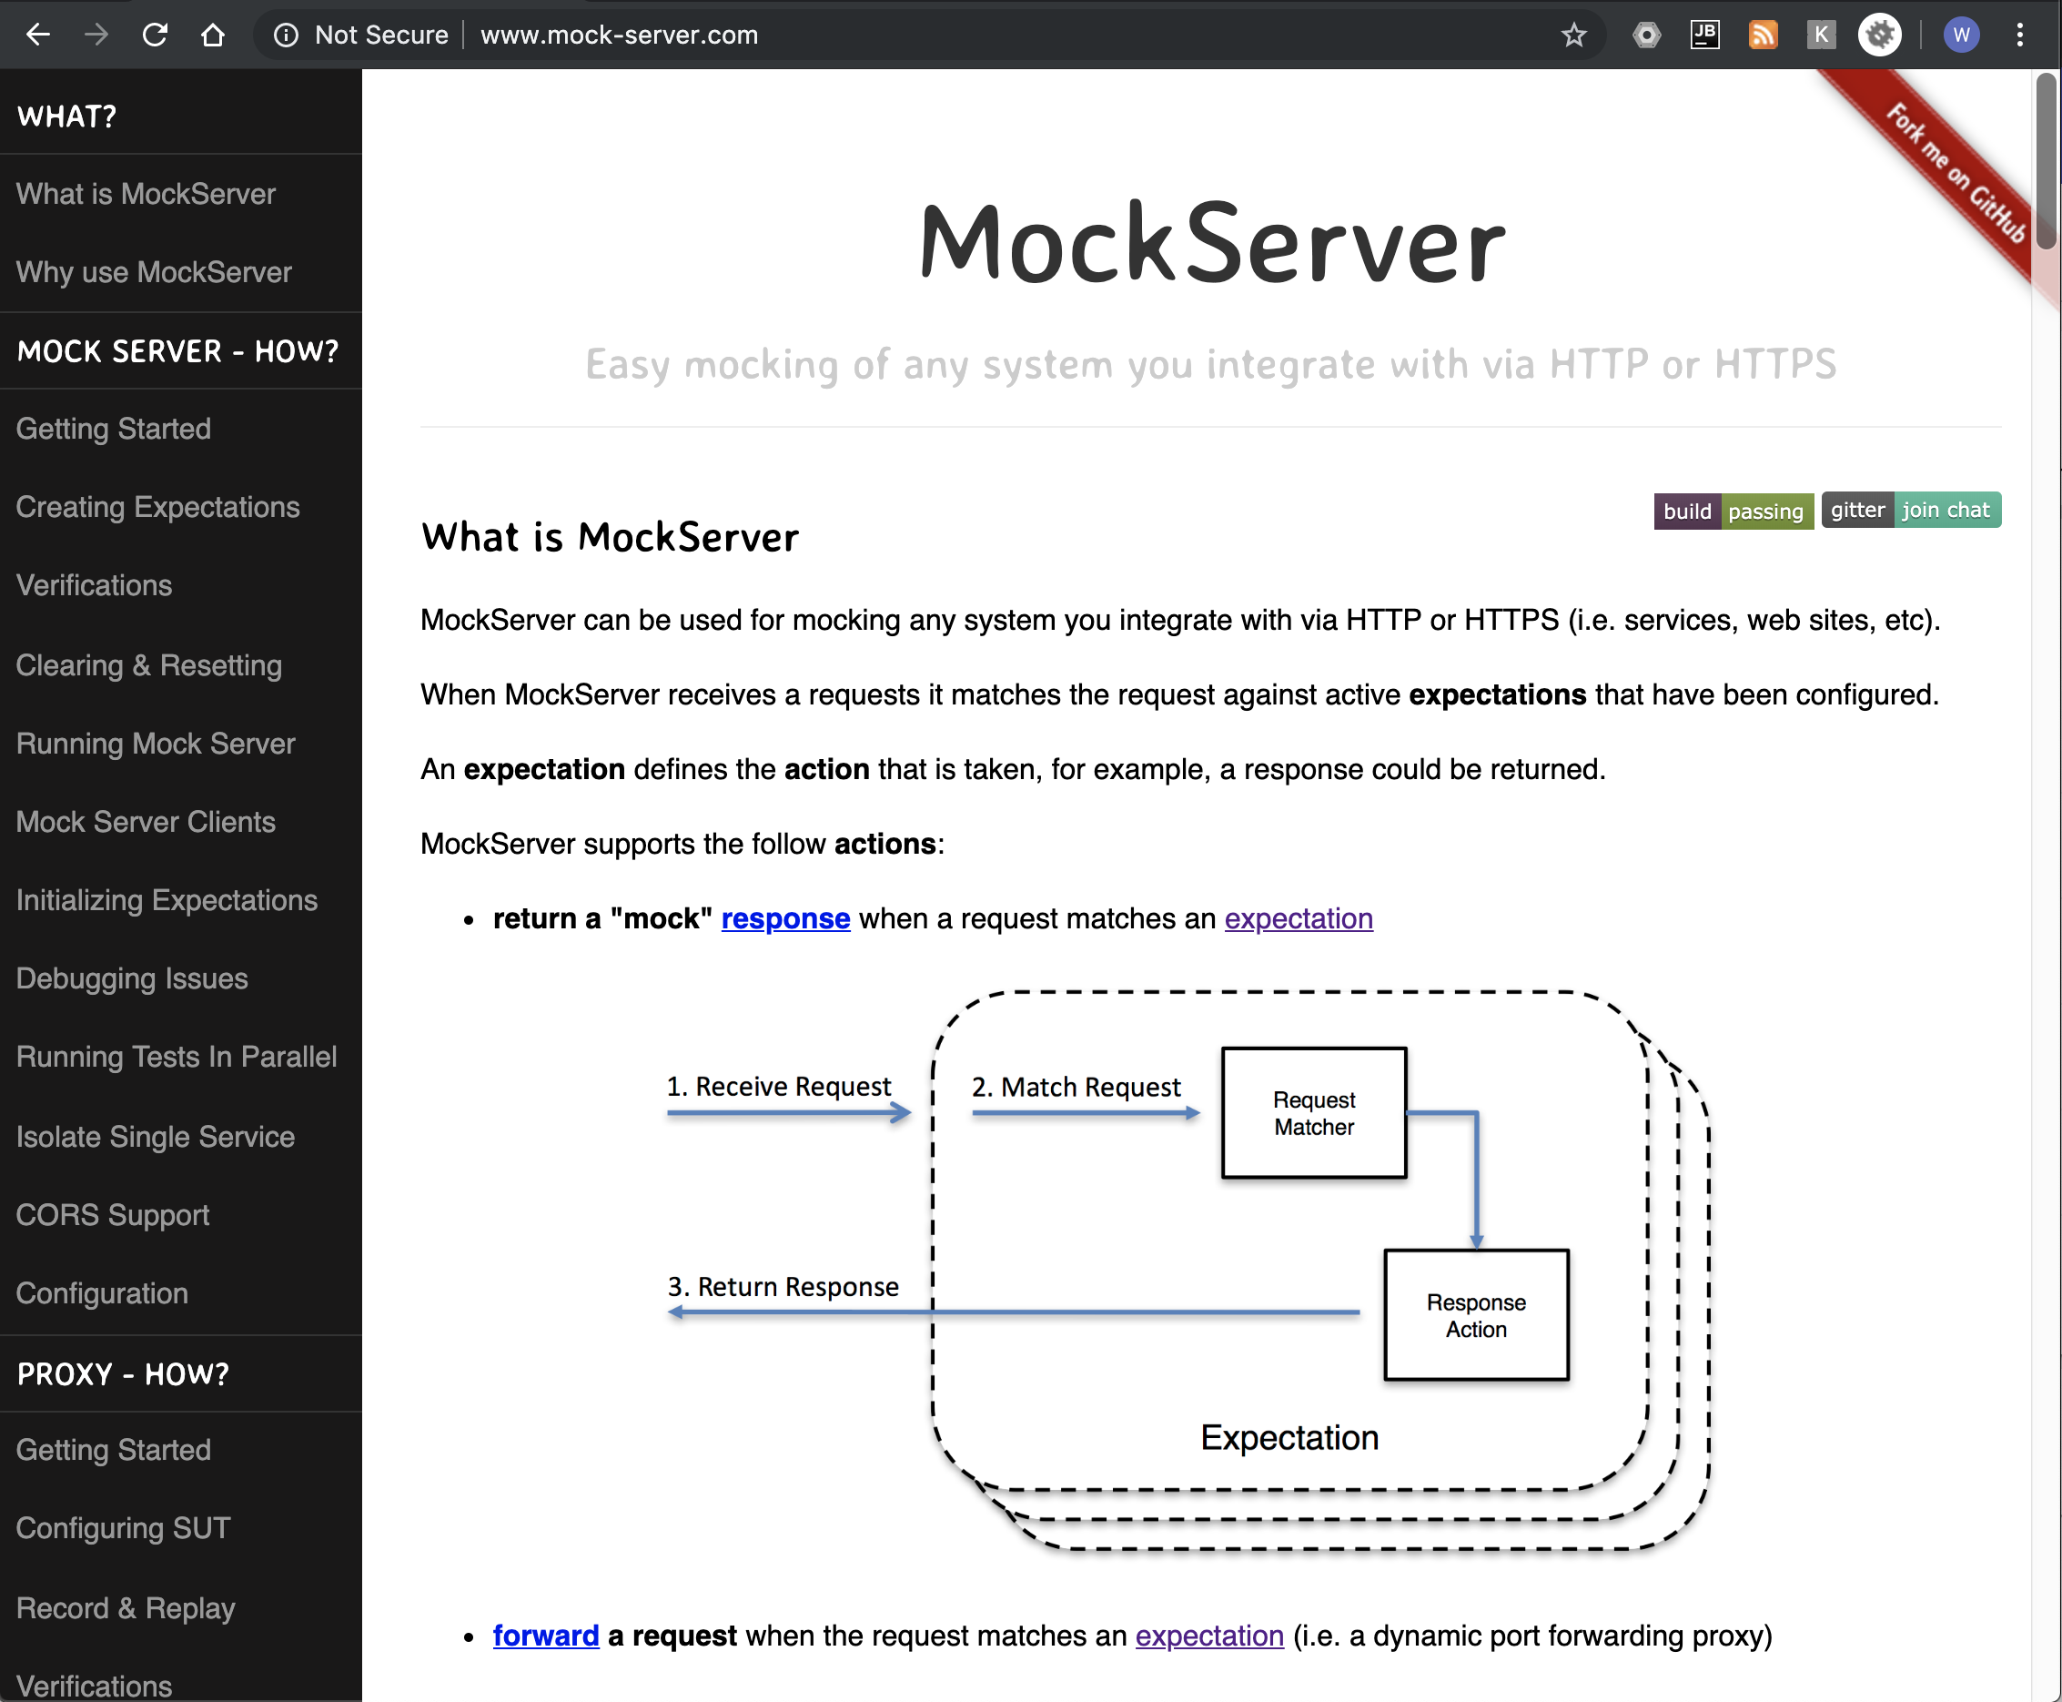
Documentation
http://www.mock-server.com/
Use REST API examples

Slide 34
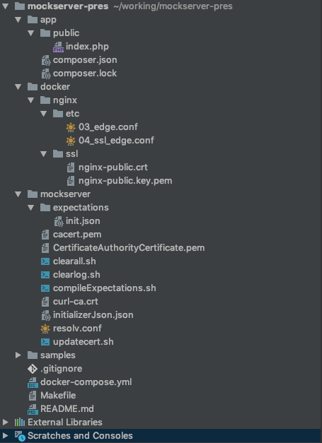
Sample App Structure
Application stored in /app dir
Nginx proxies all traffic to app or mockserver
Mockserver expetations compiled into single file
Valid SSL required for MockServer UI
MockServer CA cert embedded in PHP container
Makefile contains shortcuts

Slide 35
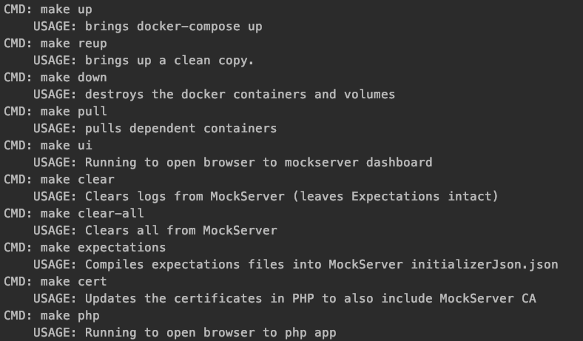
MAKE SHORTCUTS

Slide 36
Alternatives
And why I diddn’t choose them

Slide 37

The main reason…
Notes:
I did the first prototype over lunch, and selected the first solution I found with a GUI I could use.

Slide 38

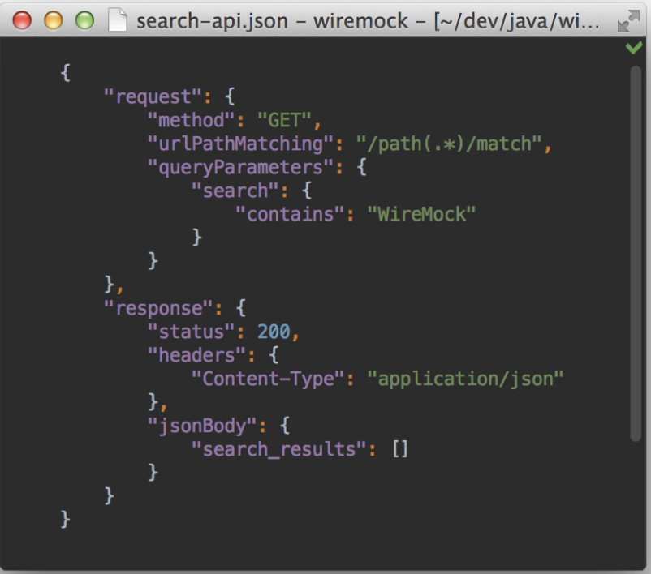
WireMock
Also written in Java
Lacks Built in UI
There are third party ones
Or one you could pay for…

Slide 39
Node-mock-server
Only swagger support.
No quick ability to forward messages and then quickly prototype a mock.

Slide 40
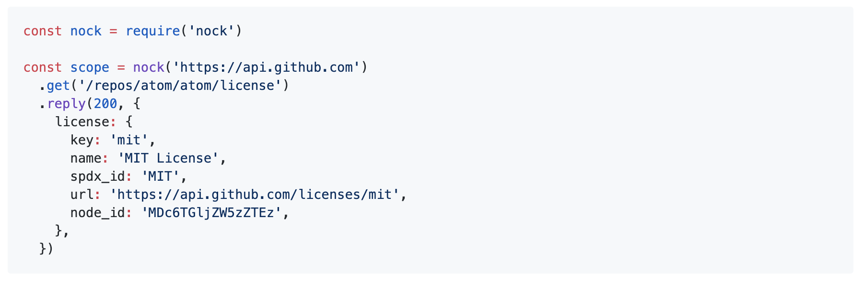
Nock
All programming
Power goes up
Ease to start goes down
No UI for usage while developing.
Lack of easy API for test verification

Slide 41
Q&A
How did we make it this far in an hour?

